Slide 1


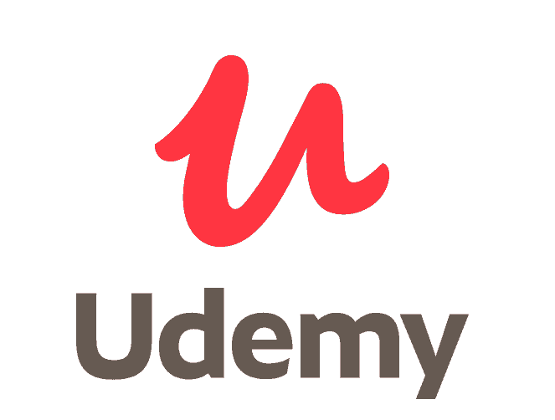

Predicting Student Churn in Massive Open Online Courses
Zach Quinn
Bellevue University

Slide 2

MOOC: A Primer
Affordable, flexible way to develop academic, technical or professional skills at scale (Edx, 2020)
Completed in fraction of the time of a college course (10 – 100 hrs vs. 200 hrs for college) (Chung, 2015)
All-inclusive & autonomous
Detailed examination of a subject vs. broader approach of college course

Slide 3
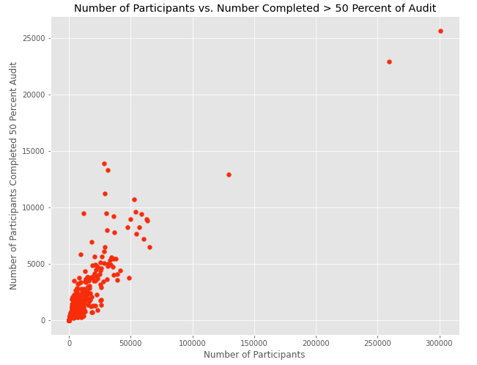
MOOC Problem: Attrition
Attrition rates for Harvard/MIT open courses with 40,000 to 60,000 students: 96% in 5 years (Murray, 2019)
Coursera/Udemy: 1 – 5% of students finish (Koller, Ng, Chen, 2013)
The retention funnel
Can’t articulate value of a course or certificate (Lederman, 2019)

Slide 4
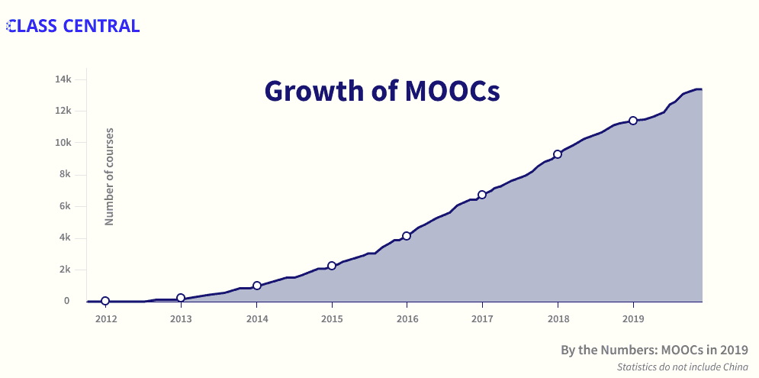
Business Problem: Churn
Customers churn due to boredom, incompatibility or dissatisfaction (Altexsoft, 2019)
Costs U.S. businesses 140 billion dollars/year
Businesses lose 1/3rd of customers after one bad experience
MOOC market projected to grow by 40% but providers continue to hemorrhage students

Slide 5
The Project At A Glance
Goal: To leverage demographic, behavioral and content-based features to predict whether or not a student will finish an MOOC
Hypothesis: By identifying and combining numeric demographic, behavioral, and content-based features in a multivariable logistic regression model, it will be possible to make a binary prediction of which students earned or did not earn a certificate of completion in a course on EDX or Udemy.
Data: A combination of four flat data sets (CSV files) including 67 variables
Methodology: Identify features that make for strong predictor variables and fit to a multivariable logistic regression classifier
Results: Highest overall accuracy: 95%, highest precision: 99%, highest recall: 94%

Slide 6
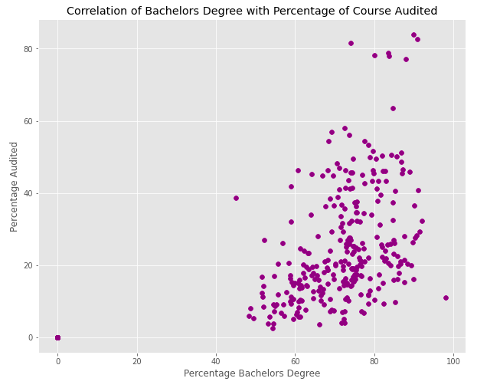
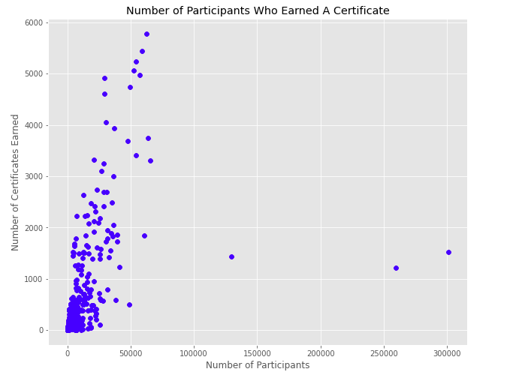
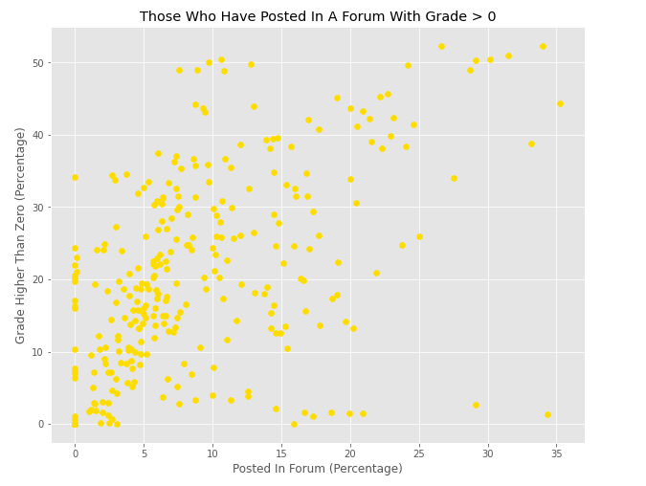
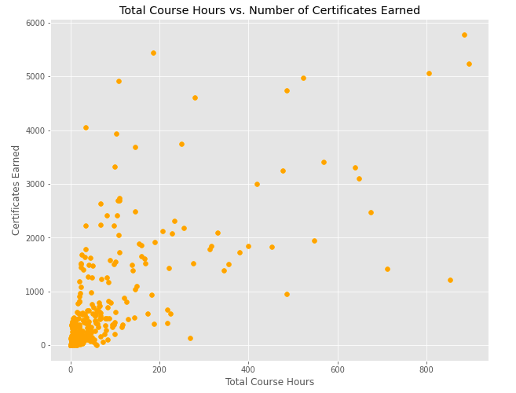
Bi-variable Relationships

Slide 7
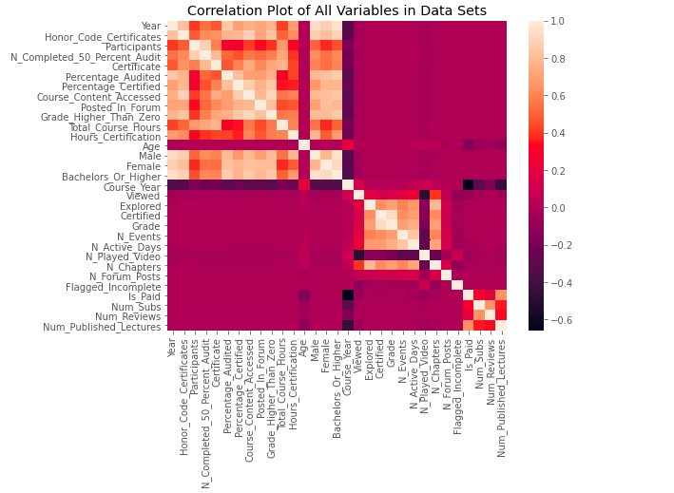
Feature Selection: All Numeric Variables

Slide 8
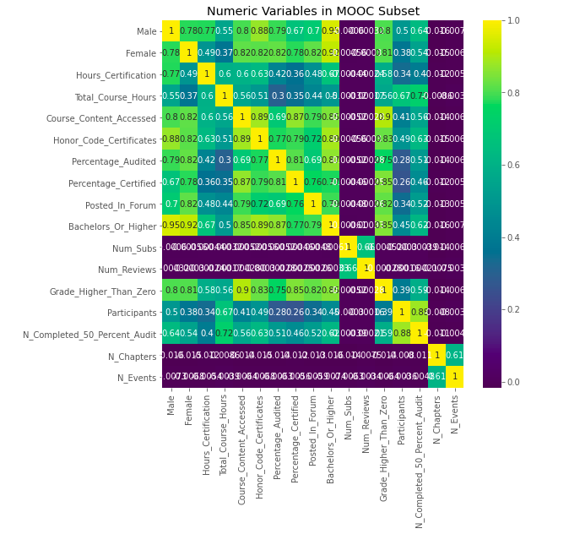
Feature Selection: Final Subset

Slide 9
The Models
Model 1 – Comprehensive
14 behavioral, demographic and content-related variables predicting ‘Certified’
Model 2 – Behavioral
6 behavioral variables (i.e. percentage of course audited) predicting whether one pays for a course certificate
Model 3 – Content-related
4 content-related variables (i.e. number of chapters) predicting whether or not one will view a module in its entirety

Slide 10
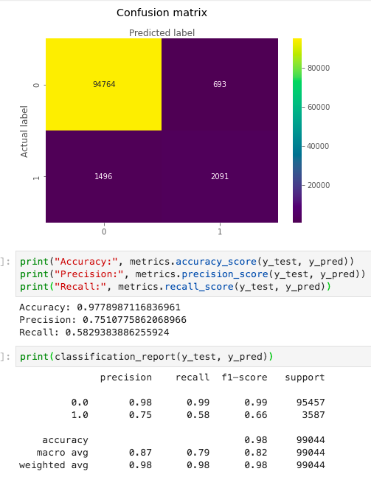
Results – Model 1

Slide 11
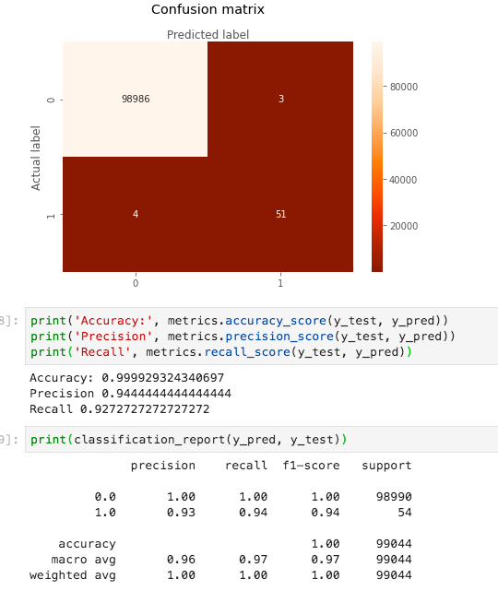
Results – Model 2

Slide 12
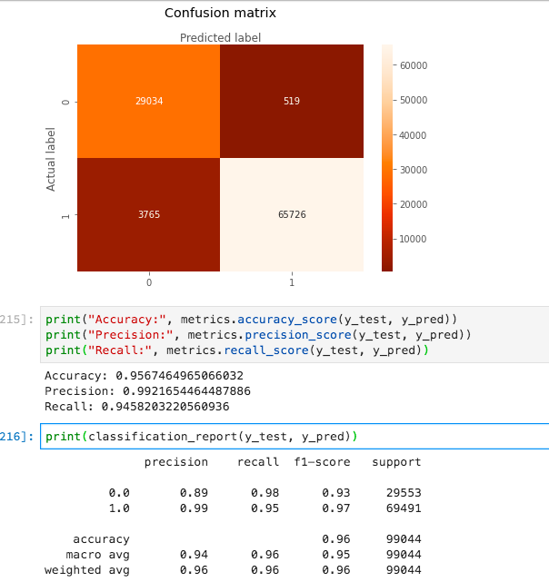
Results – Model 3

Slide 13
Conclusion
MOOC industry projected to grow by 15 billion dollars by 2022 (Sugla, 2020)
Double-digit unemployment rates (10 – 13% in 2020) likely to attract new students (Kochhar, 2020)
Project demonstrates that majority of students disinterested or disengaged
Recommendation: Decrease attrition by marketing to those whose education levels (bachelor’s degree or above) align with scope of content
Highest correlation between academic accomplishment and participation level
Future implementation: Leverage demographic info and behavioral tendencies to craft interventions

Slide 14
References (Academic)
Chung, C. (2015). MOOC-Takers Practice Flexibility: Class Central Survey Results. The Report by Class Central. https://www.classcentral.com/report/mooc-takers-practice-flexibility/
EDX. (2020). About Us. EDX. https://www.edx.org/about-us
Kochhar, R. (2020). Unemployment rose higher in three months of COVID-19 than it did in two years of the Great Recession. Pew Research Center. https://www.pewresearch.org/fact-tank/2020/06/11/unemployment-rose-higher-in-three-months-of-covid-19-than-it-did-in-two-years-of-the-great-recession/
Koller, D., Ng, A. & Chen, Z. (2013). Retention and Intention in Massive Open Online Courses: In Depth. Educause. https://er.educause.edu/articles/2013/6/retention-and-intention-in-massive-open-online-courses-in-depth
Lederman, D. (2019). Why MOOCs Didn’t Work, in 3 Data Points. Inside Higher Ed. https://www.insidehighered.com/digital-learning/article/2019/01/16/study-offers-data-show-moocs-didnt-achieve-their-goals
Murray, S. (2019). MOOCs Struggle to Lift Rock-Bottom Completion Rates. Financial Times. https://www.ft.com/content/60e90be2-1a77-11e9-b191-175523b59d1d
Sugla, S. (2020). MOOC Market by Component (Platforms (XMOOC and CMOOC), Services), Course (Humanities, Computer Science and Programming, and Business Management), User Type (High School, Undergraduate, Postgraduate, and Corporate) and Region - Global Forecast to 2023. Markets and Markets. https://www.marketsandmarkets.com/Market-Reports/massive-open-online-course-market-237288995.html

Slide 15
Image Credits
Coursera logo: https://about.coursera.org/images/logos/coursera-logo-full-rgb.png
EDX logo: https://www.edx.org/
MOOC word cloud: https://cdn.psychologytoday.com/sites/default/files/blogs/145967/2014/07/155769-159876.png
MOOC growth chart: https://www.classcentral.com/report/wp-content/uploads/2019/12/2019-roundup-growth.png
Udacity logo: https://www.udacity.com/
Udemy logo: https://digitalsharecropper.com/wp-content/uploads/2016/03/udemy-logo-e1604793745846.png

